Slide 1

Sentiment Analysis of Movie Reviews
Presented by -
Sayali Pisal - 012462385
Shruti Kothari - 013736463

Slide 2

Introduction – What?
The advent of Internet has led to an increase in the amount of sentimental content available on the Web. Such content is often found in social media web sites in the form of movie or product reviews.
The focus of our project is the analysis of the sentiments in the movie reviews. We expect the reviews to express succinctly and directly public opinion on a certain movie.
We aim to build a binary classifier to predict the sentiment given raw texts of movie reviews.

Slide 3
Why?
Reviews are available to movie production companies which helps them –
To understand sentiment and check the popularity of their films
To figure out new marketing strategies and future directions
Human mind can read and understand whether a review is positive but for movie studios it is difficult to hire employees to simply read and judge movie opinions.
So here comes Machine Learning to rescue –
Processing
Reliably extraction
Classification of the sentiment of unstructured movie reviews

Slide 4
Dataset
50k Movie Reviews
IMDB movie
reviews Dataset
25k
Train
25k
Test
12.5k
Positive
12.5k
Negative
Dataset - http://ai.stanford.edu/~amaas/data/sentiment/

Slide 5
Dataset Description
Training Dataset
Supervised dataset
Parameters : id, review, sentiment
Testing Dataset –
Unsupervised dataset
Parameters : id, review

Slide 6
Data Preprocessing
Removal of HTML tags using BeautifulSoup
Removal of punctuations and digits from the reviews
Conversion of all the reviews to lower case
Removal of stop-words using nltk library

Slide 7
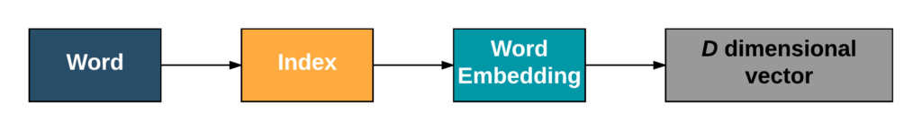
Vectorization methods
TF-IDF – Bag of Words model
Converting collection of raw review documents to a matrix of TF-IDF features.
Goal - To scale down the impact of tokens with frequent occurrence in the reviews that are less informative than the features that occur in a small fraction holding more importance.
Word2Vec model
A neural network for processing the reviews and grouping the vectors of similar words together in a vector space.
Implemented Word2Vec using Google’s pre-trained Word2Vec model.

Slide 8
Feature Engineering
Dimensionality Reduction – for reducing the number of random variables under consideration by obtaining the set of principle variables.
SelectKBest – Removes all but the k highest scoring features.
chi2 - Independence testing method to determine the dependency of two features.

Slide 9
Classification Models
Multinomial Naive Bayes
Conditional probabilistic distribution model.
Suitable for classification with discrete features especially word counts for text classification.
Random Forest
An ensemble learning classifier which builds a number of decision trees on the training data and combines all their outputs to make the best predictions on the test data.
Meta estimator that fits a number of classifying decision tress on various data sub samples.

Slide 10
Classification models (continued..)
Linear SVM using GridSearchCV
SVM is a discriminative classifier formally defined by a separating hyperplane which means given labelled training data (supervised learning), the algorithm outputs an optimal hyperplane which categorizes new examples.
Using GridSearchCV the optimised parameters and best cross validation score for linear SVM is obtained.
Logistic Regression
A predictive analysis model used for data description and to derive the relationship between one dependent binary variable and one or more nominal, ordinal, interval or ratio-level independent variables.
The logistic regression not only gives a measure of how relevant a predictor is (coefficient size) but also its direction of association (positive or negative).

Slide 11
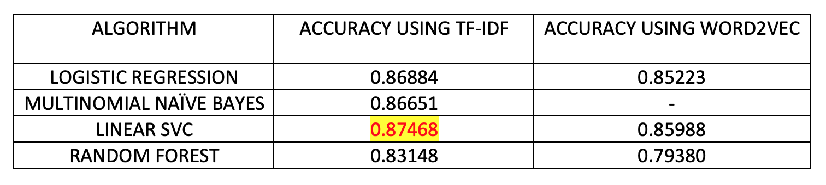
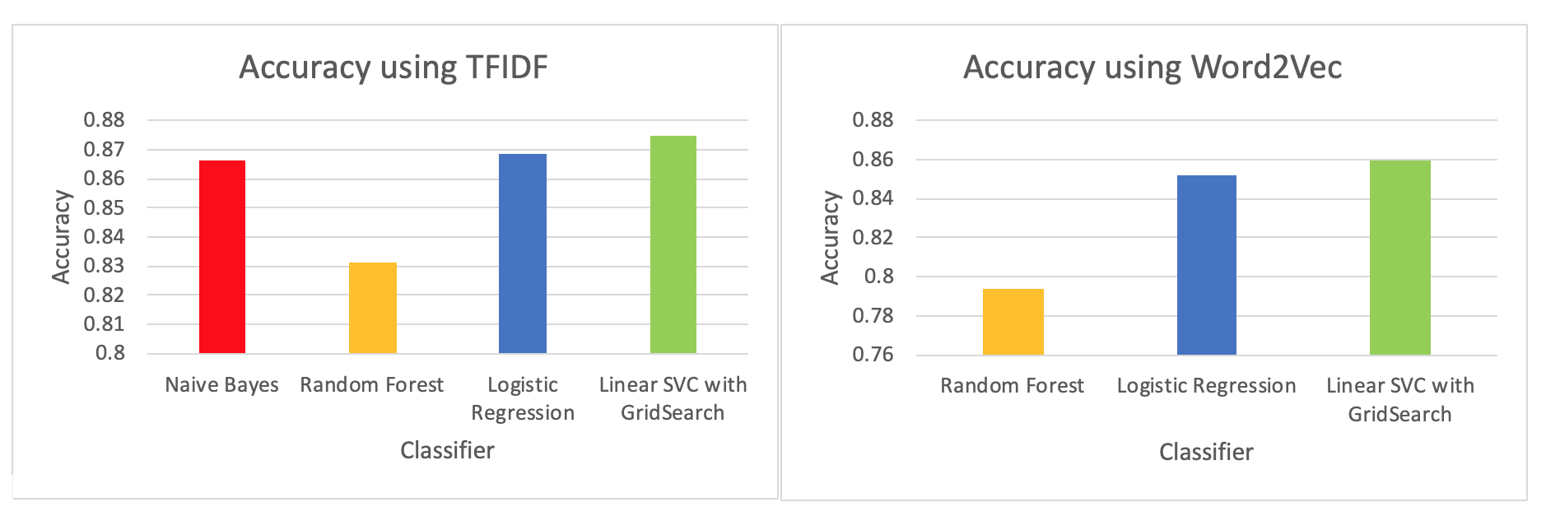
Results

Slide 12
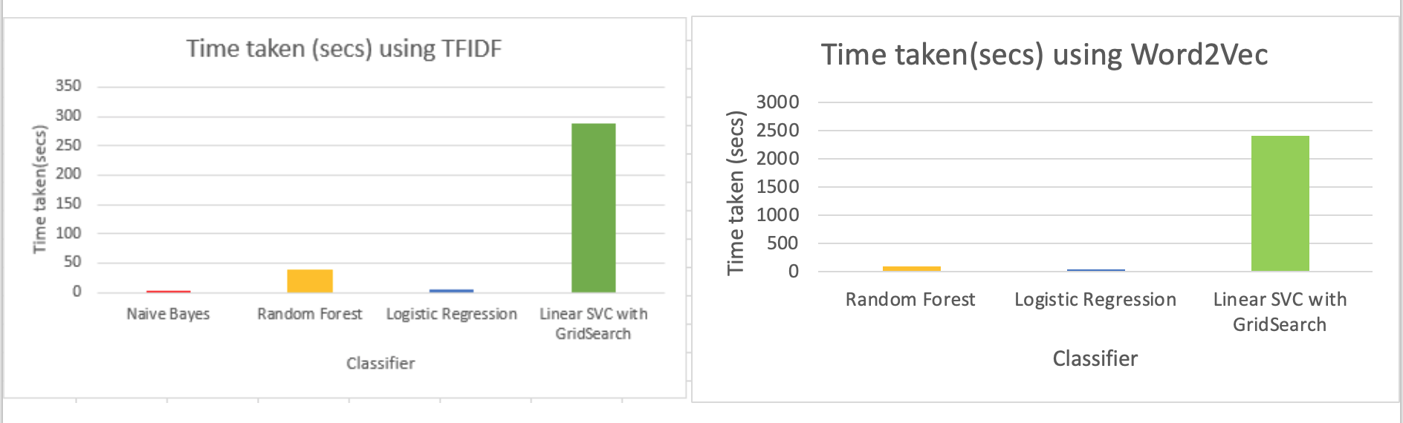
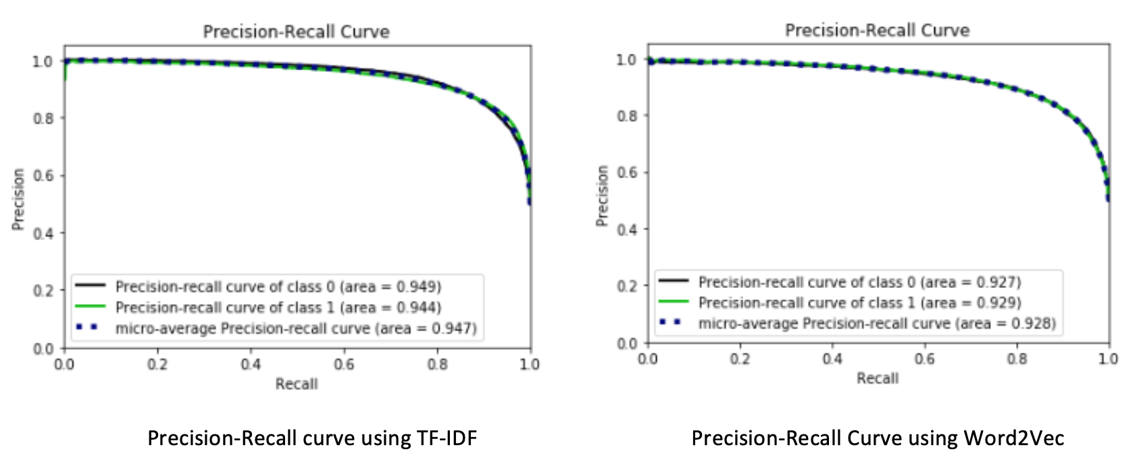
Results Continued ..

Slide 13
Live Demo!

Slide 14
Thank you!

